Slide 1
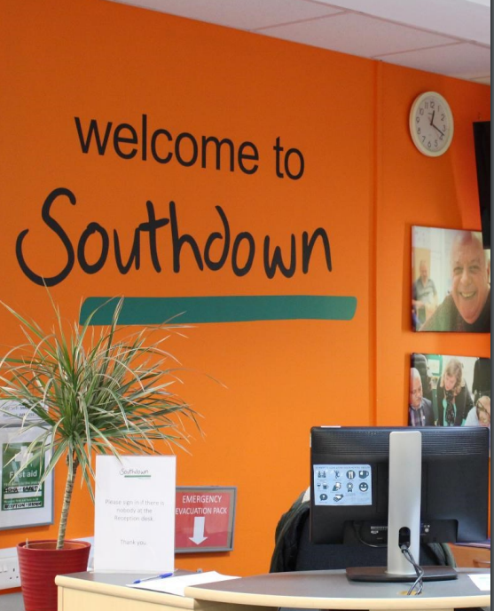
Brighton & Hove and West Sussex Mental Health Support Services Recommissioning
Partnership Briefing
19th – 27th November 2024

Slide 2
Proposed role and commitment
Act as independent Lead Provider
Build on UOK B&H partnerships
Expand opportunities for other partners, meeting diverse needs of the City
Reduce % of contracts delivered by Southdown

Slide 3
About Southdown
Charity and Specialist Housing Association since 1972
Sussex based
£32m income
850 staff
11,500 clients 2024
3,500 clients at one time
60+ support services
2 Lead Provider contracts

Slide 4
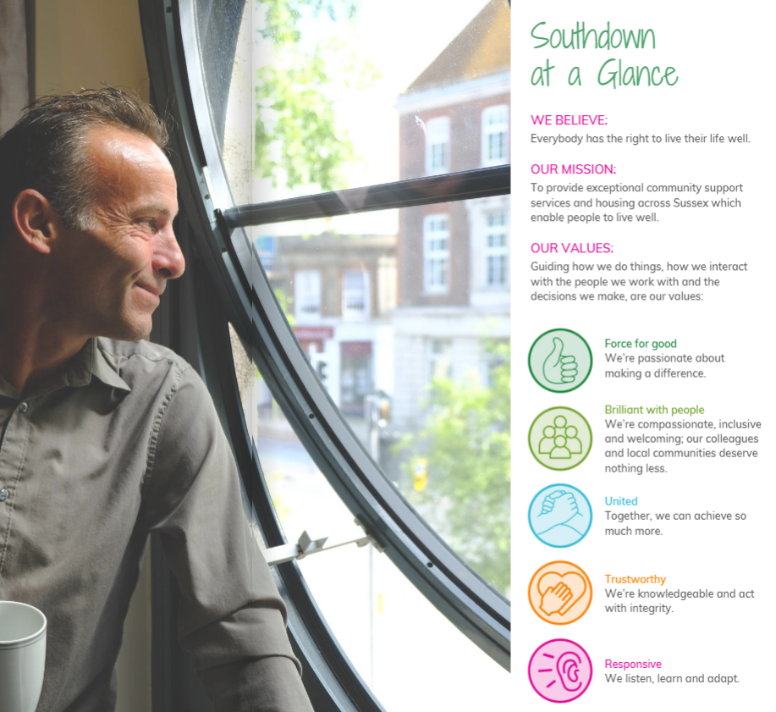

Slide 5
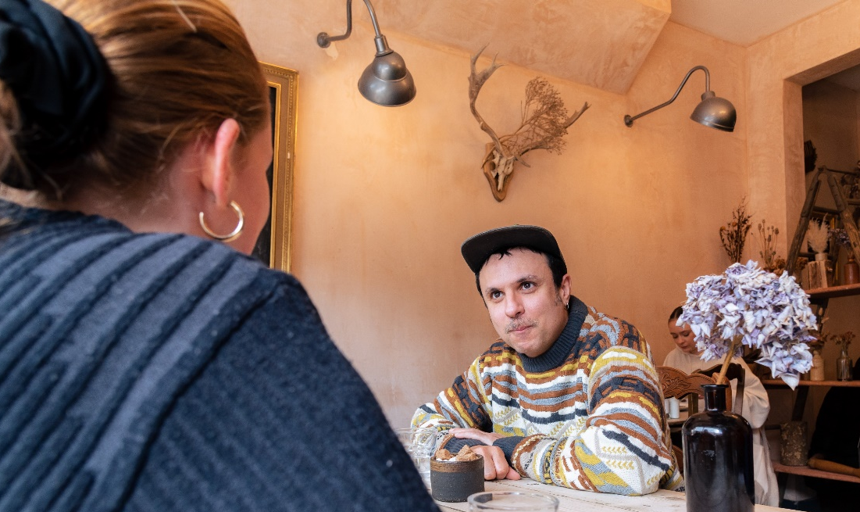
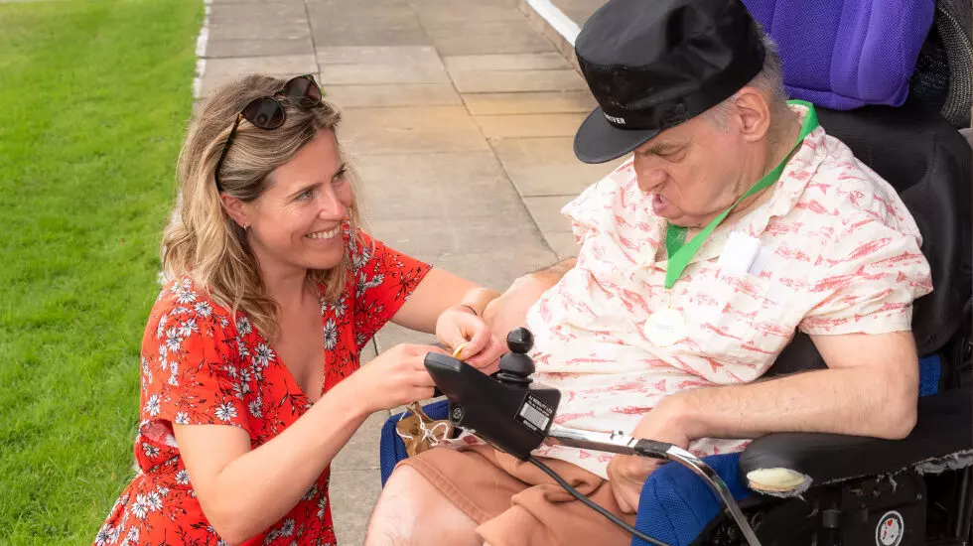
How we work
CREATE environments of safety, belonging and learning
BUILD relationships that value choice, individuality and working together
RECOGNISE individual experiences, strengths and potential

Slide 6
Lead Provider approach

Slide 7
Experience
2019 Brighton and Hove, and 2024 East Sussex
19 partners
£5.2m funding
£3.2m financial inclusion outcomes
64,000 website visits
12,805 psychosocial sessions
8,132 group sessions
1,215 people trained in Mental Health First Aid
Online mental health advice and support platform

Slide 8
What do people say…..
‘'The UOK Partnership has demonstrated the strength in partnership working to meet the diverse protected characteristic needs of our community’'
UOK B&H Partner
''It's great to have an easy access route to these useful community services''
Caller to UOK Central Access Point
''We feel part of an incredibly rich partnership with lots of expertise on a range of issues related to mental health and supporting communities''
UOK B&H Partner
"I found UOK very helpful.
I felt I was listened to and am now on track to follow the signposts given"
Caller to UOK Central Access Point

Slide 9
Vision and Mission
Our Vision:
We envision a vibrant, inclusive mental health network across Sussex, rooted in local neighbourhoods and led by the VCSE sector.
Our Mission:
Together, with people with lived experience, we’re reshaping mental health support to be accessible, responsive, and reflective of our diverse communities’ unique needs

Slide 10
Goals and Values
Our goal:
To empower individuals and neighbourhoods toward brighter, healthier futures while reducing the reliance on hospital-based care.
Our approach is guided by Values and Principles
of inclusivity, diversity, collaboration, generosity, and local insight.

Slide 11
Role as Lead Provider
Deliver Quality, Person-Centred Care
Drive Strategic Partnerships
Strengthen Capacity Across Our Network
Stay Agile to Community Needs

Slide 12
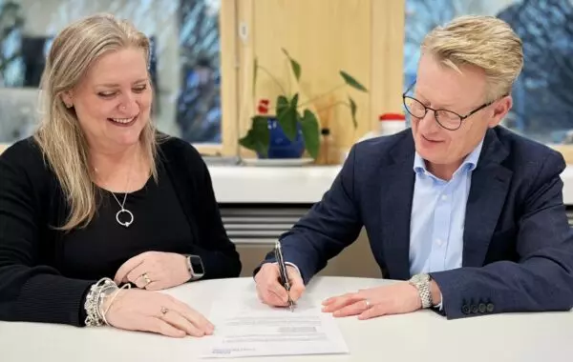
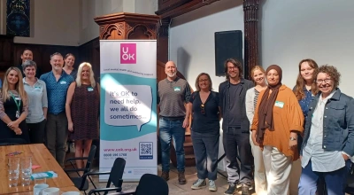
Lead Provider capabilities
Co-production
Generous leadership
Sector representation
Governance
Funding distribution
Procurement & Contract Management
Data Reporting
Innovation
Notes:
Generous leadership: we use our scale and resources to benefit the wider sector.
Sector Leadership: through our representation roles and strategic relationship management, we amplify the voice of the sector to influence meaningful change.
Commitment to Learning: having pioneered the Lead Provider role for mental health services in Sussex since 2019 we have evolved our approach based on feedback and learning against significant system challenges and transformation.
Governance: Dedicated Partnership Lead roles, supported by transparent governance structures, enable fair, accountable service provision.
Procurement & Contract Management: Expertise in subcontracting and performance management ensures efficient service delivery and funding oversight.
Data Reporting: A tailored subcontractor client record system, managed by Data Analysts, ensures streamlined and clear partner reporting.

Slide 13
Honest learning…..
Common goal versus independent missions
Trust and Transparency
Proportionality of contract requirements
Stability and transformation
Funding cuts
Sub-contractor performance

Slide 14
Lead Provider role to develop services

Slide 15
Coproduction in redesign
East Sussex Wellbeing Centre redesign (UOK)
6-month process over 10 sessions
VCSE providers and people with lived experience
Paid participation
4 stages - Scope; Empathise; Define; Ideate; Prototype
Personas
Outcome = open procurement based on agreed specification (transfer of services from Southdown)

Slide 16
What do we know about local mental health needs?
Tasha Barefield
Engagement and Coproduction Lead
Possability People

Slide 17
What does the B&H Mental Health JSNA 2022 tell us?
Increase of mental ill health and deepening inequalities with vulnerable groups being disproportionately affected. Post COVID-19 pandemic and Cost of living crisis.
The government defines prevention as “helping people stay healthy, happy and independent for as long as possible.” Prevention works and is cost-effective.
Compared to the South East and England, the city has a younger population with more young adults, fewer children and older people.
Groups with very high needs locally:
People with alcohol and/or drug dependence
People experiencing homelessness
People with complex needs and multiple disadvantage
https://www.brighton-hove.gov.uk/sites/default/files/2023-01/Mental%20health%20JSNA%20Executive%20summary.pdf

Slide 18
Other population groups with increased risk locally include:
Ethnic minority groups
Lesbian, gay, bi, trans, queer, questioning, asexual (LGBTQ+) people
People with long-term physical health conditions
People living with physical disabilities
People living with learning disabilities
People with sensory impairment
Carers
Neurodivergent people
Migrants, refugees, asylum seekers and stateless persons
Gypsy, Roma and Travellers
Children in care and care leavers
Mothers of children taken into care
Students
Armed forces personnel and veterans
Prison population, offenders and victims of crime.

Slide 19
Level of need in Brighton & Hove
It is estimated that 1 in 5 people living in the city has a common mental health problem (1 in 6 nationally).
Compared to England, Brighton & Hove has:
A lower proportion of the population who feel that the things they do in life are worthwhile.
More people reporting depression and anxiety.
A greater proportion of people are diagnosed with a severe mental illness.
More Employment Support Allowance (ESA) claimants for mental/ behavioural disorders.
High needs found from adult assessments for those with multiple long-term conditions, adults with multiple complex needs, international migrants and trans people.

Slide 20
Outcomes compared to wider England
Brighton & Hove has areas of poorer mental health outcomes.
The greatest disability-adjusted life years due to mental health illness of any local authority in the South East, for both males and females.
Has significantly worse rates than England of premature mortality of adults with severe mental illness, Detentions under the Mental Health Act 1983 and emergency hospital admissions for self-harm.
The city has had one of the highest rates of suicide in England, with rates significantly higher for several years. Our rates remain higher in both men and women.

Slide 21
Voice of working age adults
Common issues highlighted through the review include the need for:
More accessible support and services, and support promoted more widely.
Simplify the referral processes, including for self-referral.
Consider all needs, not just mental health (thresholds often on single issues) e.g. dual diagnosis.
More joined-up services, working better together. Better information sharing between services.
More involvement of peers and people with lived experience in developing services and more development of peer support roles.

Slide 22
Voice of working age adults
Common issues highlighted through the review include the need for:
Taking a more trauma-informed approach.
More mental health awareness and suicide prevention training.
Waiting times reduced and more support for those on waiting lists/who don’t meet thresholds.
Higher levels of / more accessible support for those who were recently discharged from an in-patient stay.
More support to families and carers supporting those with mental illnesses.

Slide 23
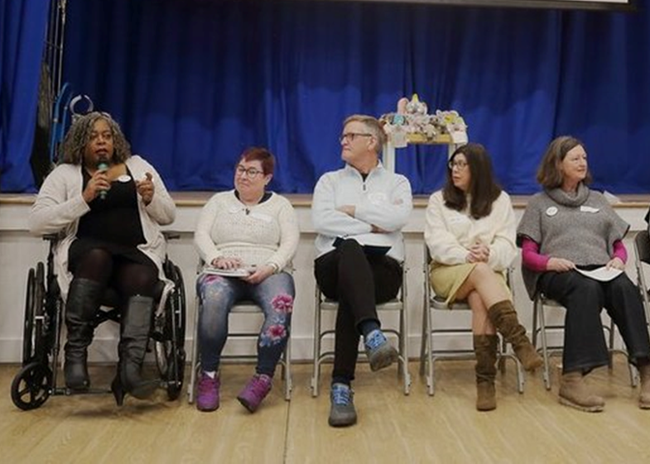
Brighton & Hove Mental Health Lived Experience Advisory Group
LEAG was established in 2021.
We work alongside commissioners and mental health staff.
Share our feedback, challenge decisions and support the co-production of the Community Mental Health Transformation Programme.
We have spoken with over 300 people about their experiences of mental health services.
We have meaningfully involved and supported 37 people in lived experience roles.

Slide 24
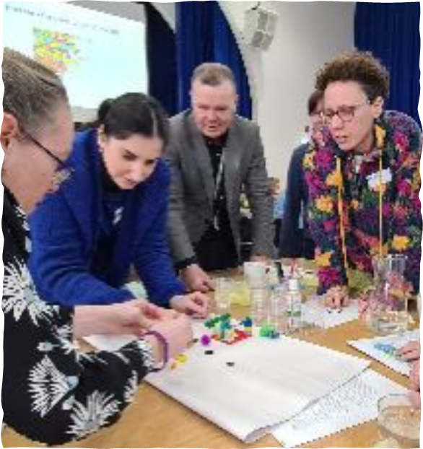
What has the B&H Lived Experience Advisory Group been saying? (1)
Peer support is essential - we need it in every mental health service working alongside clinicians.
Trauma support and interventions are lacking for all those who desperately need it.
Our use of language and labels in mental health is important and affects the way people interact with services.
There are still large gaps between services meaning people cannot access the support they need due to service thresholds and barriers to access.
Signposting is essential to get right, people need guided signposting and they need easy-to-use digital and printed information.
People are concerned about their data records and how they are shared and used across services.
People want services to talk to each other and communicate better so they don’t have to keep repeating their needs and history.
People still do not get the help they need when they are struggling or in crisis.

Slide 25
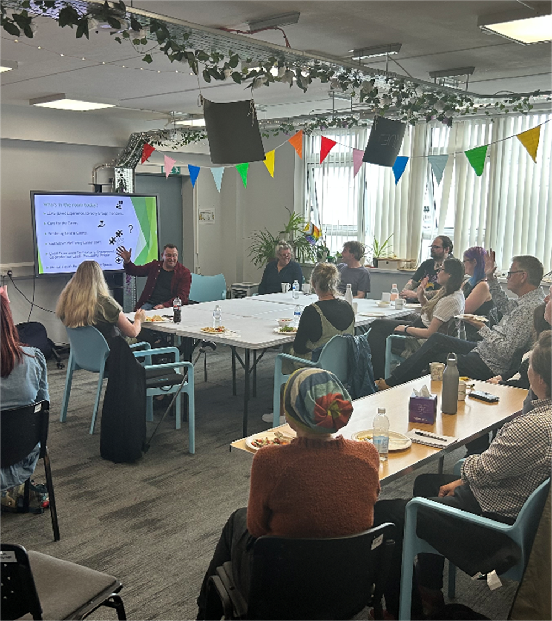
What has the B&H Lived Experience Advisory Group been saying? (2)
Services need to understand the lived experience and carer perspectives to ensure their services are accessible and effective.
People want to be part of their own recovery decisions.
Carers, friends and family involvement and information are essential, many people needing help cannot advocate for themselves.
Staff need to reflect our communities - people want to see people like them in mental health spaces.
People want different mental health service delivery offers - online, in person, close to home, evening and weekend services.
People do not want to have to keep completing new assessments and forms for every service they access.
Support for people who are neurodivergent is needed, services are often not neurodivergent friendly or supportive and staff are not sufficiently trained to understand people’s needs.

Slide 26
MHSS Recommissioning Engagement Workshop
27th November 2024
CAPITAL and Southdown
West Sussex

Slide 27
Introduction
Duncan Marshall, CEO CAPITAL
Independent Review for MHSS in West Sussex on behalf of Southdown
Review team includes Lydia Taylor, Lived Experience Consultant
Our Aims:
Provide accounts of the public's perception in West Sussex
Share insights from those with lived experience in West Sussex
Support Southdown with analysis and recommendations.

Slide 28
What do we know so far?
Mental Health Needs Assessment in WSX Summary:
Overall Reflections/ Recommendations:
More timely and accessible services
Reduction in service provision gaps
Informed & coordinated MHSS
Personalised care
Holistic support considerations
Examples of Considerations:
Accessibility of Information
System-wide approach through different aged services
Preventative support rather than reactive
Review of staffing resources & effectiveness
Improved out-of-hours support.
Account from Mental Health Needs Assessment in WSx
Voices of those with Lived Experience.

Slide 29
What do we know so far?
WSX Lived Experience Advisory Group (LEAG):
Overall Reflections/ Recommendations:
There is a lack of Trauma support.
The use of language and labels in Mental Health is very important and impacts engagement. This includes the effectiveness of signposting.
There are large gaps between services leading to barriers.
People want to be part of their own recovery decisions. If this isn't possible the family, friends and carers involvement is essential for advocation.
Examples of Considerations:
Peer support is essential and should be available in every service.
An improvement in transparency about data record keeping and sharing.
Increase, promote and improve continuity between services, they need to work together.
Lived experience input, including carers is essential.
Improve accessibility of services and their delivery.
Better understanding and support for Neurodivergent people. Current services do not meet people's needs.
Voices of those with Lived Experience.

Slide 30
Thank you and questions
CAPITAL and Southdown
West Sussex

Slide 31
What is in the Specification?

Slide 32
Overview of MHSS in Brighton & Hove and West Sussex
Overview of Mental Health Support Services (MHSS)
Aim: Improve adult mental health and wellbeing in Brighton & Hove and West Sussex.
Focus: Inclusivity, prevention, and addressing health inequalities.
Core Principles:
Address health inequalities and promote inclusivity.
Co-produce services with users, carers, and communities.
Deliver accessible, person-centred support.
Foster partnership across health and care systems.
Provide evidence-based and trauma-informed care.
Innovate to meet local needs.
Promote prevention and reduce mental health stigma.

Slide 33
Key Services Areas
1. Provider Responsibilities:
Governance, data collection, and system leadership.
Establish/sustain independent Lived Experience Advisory Group (LEAG).
2. Community Development, Prevention, and Promotion:
Strengthen community wellbeing through asset-based development.
Anti-stigma campaigns, workforce training, and suicide prevention initiatives.
3. Advice, Information, and Guidance:
Early intervention, peer support, digital resources, and social prescribing.
Focus on practical support like welfare, housing, and debt advice.
4. Getting Support:
Personalised care plans, crisis support, and behavioural interventions.
Integration with wider health interventions and services.
Align with Neighbourhood Integrated Community Teams (ICT) and the NHMT model to deliver seamless, integrated care.

Slide 34
Accessibility and Eligibility
Eligibility:
Adults with wellbeing or functional mental health needs, including:
High-risk groups (e.g., suicide risk, marginalised populations).
Families and carers of individuals with mental health issues.
Targeted communities (e.g., LGBTQ+, ethnic minorities, neurodivergent individuals).
Exclusions:
Specialist dementia services, under-18s (unless transitional), secondary care needs.
Access:
Open-access with self-referral options.
Coordinated triage (incl. NMHTs) to ensure appropriate interventions.
Processes to increase ease of access and reduce barriers for underserved communities

Slide 35
Neighbourhood Mental Health teams Overview
We are currently seeing increasing mental health need in our communities and a demand for a more responsive service.
People don’t want more individual services with niche referral pathways, but for the ones that exist to be more joined up.
People report finding it difficult to access services, long waiting lists, lack of access to therapeutic interventions, repeated assessments, and variable continuity of care.
Staff have a lack of access to advice and guidance, often looking after complex patients without support, and poor communication.
This is about developing strong working partnerships, rather than new investments.

Slide 36
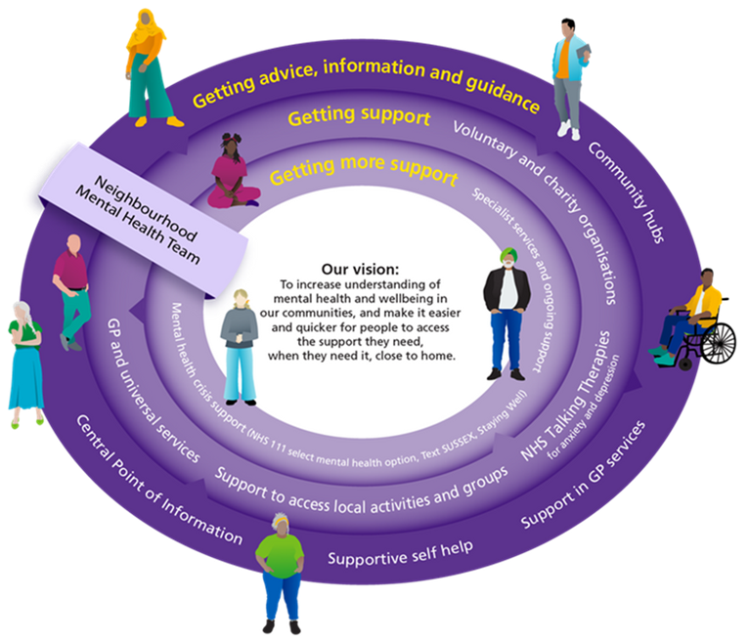
Neighbourhood Mental Health Teams Model
The community transformation brings together local services in, including mental health:
social care
primary and secondary care
Voluntary, community and social
enterprise services (VCSEs).
The new services will be designed
around the needs of
the local community
and developed in
collaboration with the people
who will use and work in them.

Slide 37
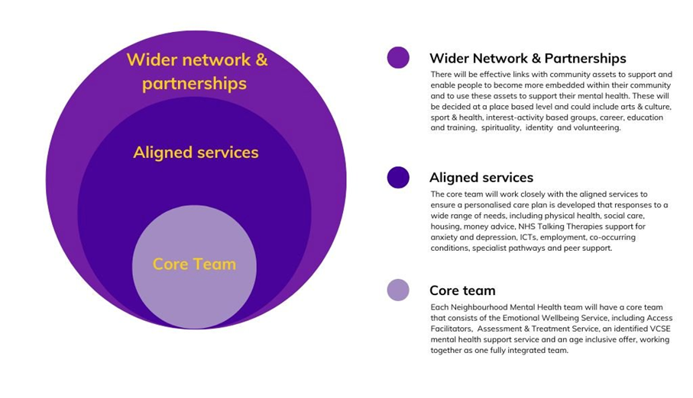
Neighbourhood Mental Health Teams Model Staffing Structure

Slide 38
Governance and funding?
Governance:
Robust quality assurance and compliance with standards.
Collaboration with commissioners to align with local health priorities.
Maintain independent Lived Experience Advisory Group for service planning and oversight.
Funding:
Brighton & Hove: £1.93M, West Sussex: £5.03M.
Lead provider limited to 50% direct service delivery to ensure market diversity.
Community development and staffing funded via joint agreements with Primary Care Networks.

Slide 39
Sustainability and Quality Standards
Sustainability:
Services accessible via sustainable transport options (e.g., walking, cycling, public transport).
Reduce emissions, waste, and promote circular economy principles.
Quality Standards:
Compliance with NICE guidelines (e.g., NG225: Self-harm, QS189: Suicide Prevention).
Regular evaluation through Key Performance Indicators (KPIs) and user feedback (PREMs).
Voice and Engagement:
Co-produced services with meaningful input from users, carers, and communities.
Lived Experience Advisory Group to influence planning and delivery.
Continuous community engagement to improve service quality and inclusivity

Slide 40
Tender Timetable
 | Stage | Dates
1 | Invitation to Tender (ITT) released to Bidders | 15/11/24
2 | Deadline for Bidders to submit clarification questions (5pm) | 06/01/25
3 | Deadline for Commissioner response to CQs (5pm) | 10/01/25
4 | Bid submission closing date (12 noon) | 20/01/25
5 | Evaluation of Bids (completion) | 26/03/25
6 | Notification of decision - Standstill period | 06/05/25
7 | Contract Award | 21/05/25
8 | Mobilisation Period | 21/06/25
9 | Service commencement date | 01/10/25

Slide 41
Thank you
Please contact:
MHSSRecommissioning.SouthdownTender@ southdown.org

